Slide 1
Notes:
DENISE
As we thought about ideas the relationship between fast food and health came up, but we pretty much know what it does to your cardiovascular health but what about mental health?

Slide 2
Notes:
DENISE
In order to relate fast food and mental health we came up with this scenario
Scenario: McDs is considering advocacy campaigns to boost it’s image. NAMI(National Alliance for Mental Illness) is a potential partner, but McDs wants to know if it will make a greater impact to run at a National level or locally, through each McDs location.

Slide 3
Notes:
DENISE
We realized the question was asking multiple things so, we broke it down into smaller questions.
We must first see what mcdonalds location targeting is
We then looked at whether or not there were relationship between that targeting and mortality rates
Then we took a look at whether or not mcdonalds locations had a relationship with mort rates

Slide 4
Notes:
DENISE
For each breakdown question
2.Considering access to treatment facilities and culture for seeking treatment

Slide 5
Notes:
MELANIE
Where did we find it?
Kaggle, GHDx, UDSA Economic Research Service
CDC Wonder: Center for Disease Control and Prevention for analyzing Mental Health Deaths in the year 2014.
How did we clean it?
Merged data on FIPS code which indicates county and state
Removed state and U.S. data
Removed duplicate rows and columns
Dropped NaN values within a subset of the data for each analysis
11 columns x 2074 rows

Slide 6

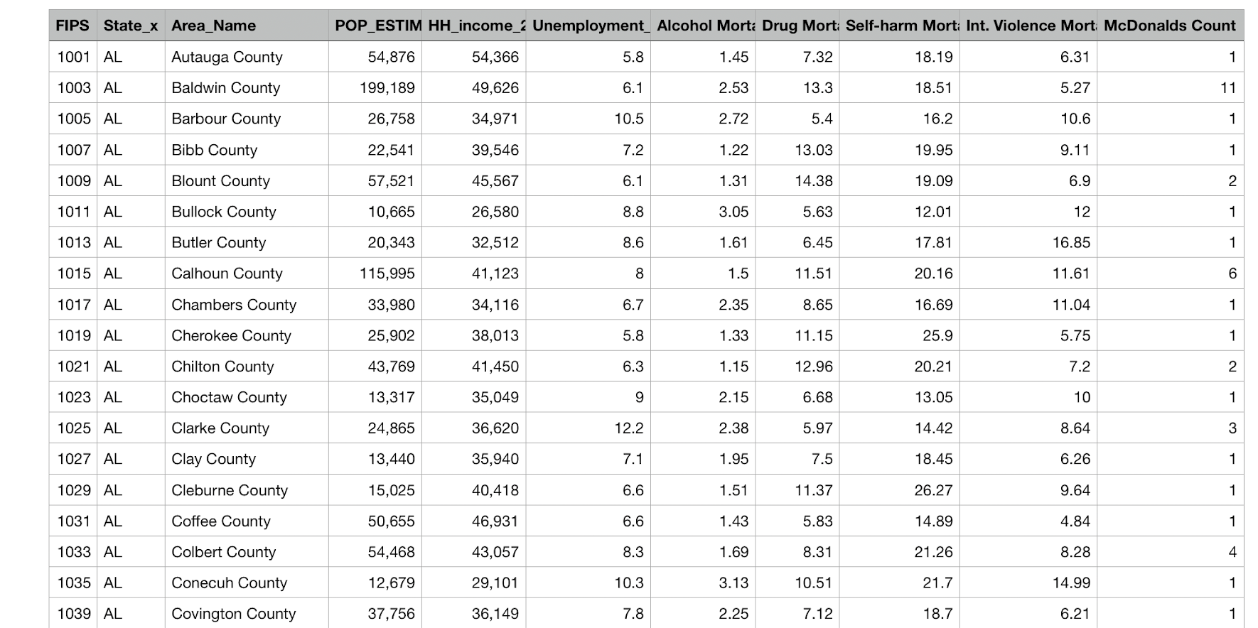
Notes:
11 columns x 2074 rows

Slide 7
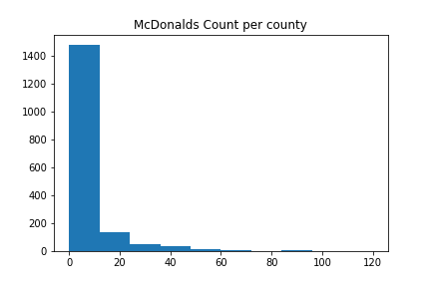
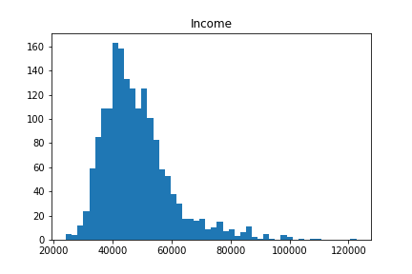
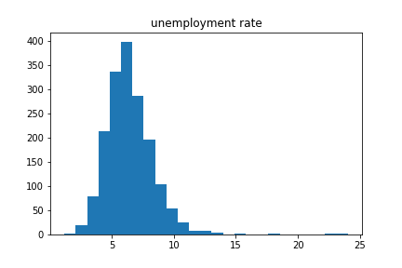
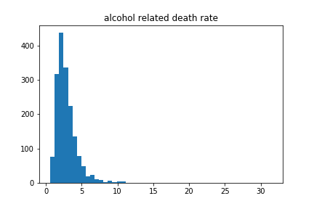
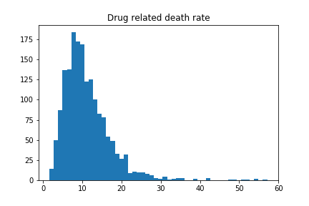
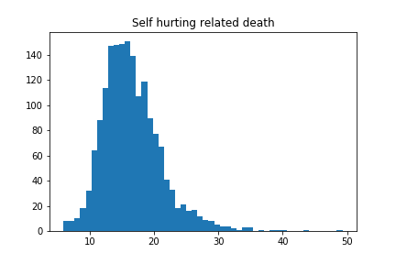

Slide 8
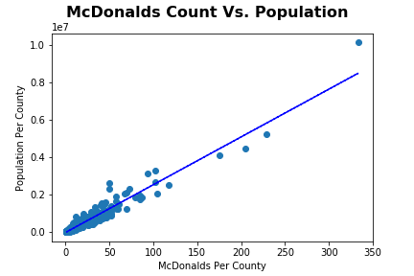
Coefficient/Slope = 25514.18
P-value = 0.0
R-Value = 0.971017
How does Population affect the number of McDonald’s?
Notes:
DARWIN
Explain how we tested
There is a clear positive relationship between the population by county and the number of McDonald's there is in a county.
slope=25514.178132725545, intercept=-19337.666993152758, rvalue=0.9710176738171435, pvalue=0.0, stderr=150.68374960370525

Slide 9
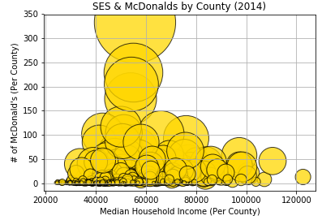
Coefficient/Slope = 0.24
P-value = 3.28 e-24
Note: Bubble size correlates to population by county.
What does the Median Income per county say about the number of McDonald's in these areas?
Notes:
DARWIN
Chart suggests there is a relationship between income areas whose median income is less than 80,000. Also suggesting that high income areas tend to have a smaller population than low to middle income areas.
Low R-Squared: .87 | Middle R-Squared: .83 | High R-squared: .45

Slide 10
Effect | P-value | Fail to Reject/Reject Null
Population | 0.0 | Reject Null
Income | 3.28 e-24 | Reject Null
Notes:
DARWIN

Slide 11
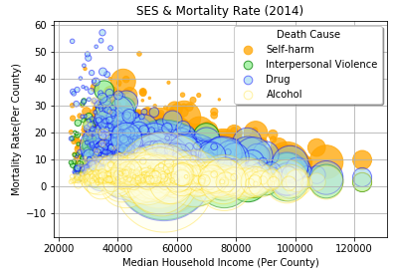
Coefficient/Slope
Drug = -0.333
Self-harm = - 0.3877
Alcohol = - 0.178
Int. Violence = - 0.4145
P-value
Drug = 1.72e-46
Self-harm = 1.79e-63
Int. Violence = 3.519e-73
Alcohol = 5.579e-14
Note: Bubble size correlates to population by county.
Notes:
Tessy
High mortality rate in low income counties. Which is why our slope have negative values, low income high mortality rate, small drug related death causes

Slide 12
Death Cause | P-value | Fail to Reject/Reject Null
Drug | 1.72e-46 | Reject Null
Self-harm | 1.79e-63 | Reject Null
Interpersonal Violence | 3.519e-73 | Reject Null
Alcohol | 5.579e-14 | Reject Null
Notes:
TESSY

Slide 13
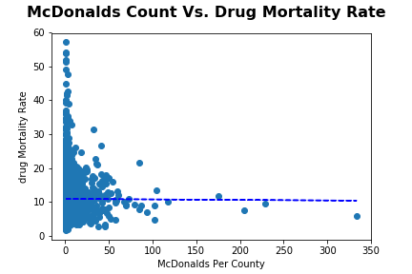
Coefficient/Slope = - 0.00152
P-value = 0.866
R-Value = -0.00356230
Notes:
DJ
Explain how we tested
slope=-0.0015172729715478583, intercept=10.912502237117929, rvalue=-0.0035623084637755676, pvalue=0.8660374925357086, stderr=0.008993211481919332

Slide 14
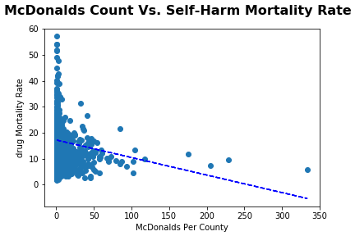
Coefficient/Slope = - 0.06767
P-value = 1.179e-22
R-Value = -0.204656
Notes:
DJ
Explain how we tested
slope=-0.06767191604935707, intercept=17.223640060088385, rvalue=-0.2046567223550048, pvalue=1.1785118787616479e-22, stderr=0.0068340284668845395

Slide 15
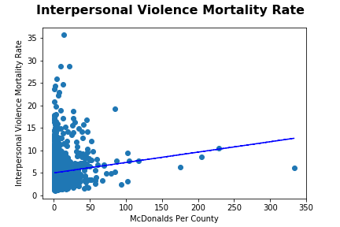
Coefficient/Slope=0.02316
P-value = 4.574 e-06
R-value = 0.10965792
Notes:
DJ
Explain how we tested
slope=0.023159351700883558, intercept=4.980061104704483, rvalue=0.10965792293440513, pvalue=4.574319979381036e-06, stderr=0.005036855382781535

Slide 16
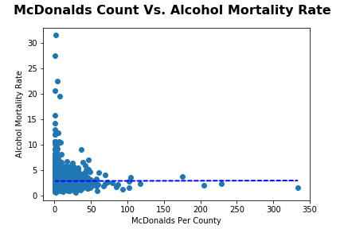
Coefficient/Slope = 0.00016
P-value = 0.953
R-value=0.0012533707
Notes:
DJ
Explain how we tested
slope=0.0001586975022142896, intercept=2.898519300587145, rvalue=0.0012533707322605323, pvalue=0.9526705910206207, stderr=0.0026734715337222827

Slide 17
Death Cause | P-value | Fail to Reject/Reject Null
Drug | 0.866 | Fail to Reject
Self-harm | 1.179 e-22 | Reject
Interpersonal Violence | 4.574 e-06 | Reject
Alcohol | 0.953 | Fail to Reject
Notes:
ZACK

Slide 18

Failed to reject null hypotheses
McDonald’s Count vs. Population/Income
Population (+)
Income (+)
Income vs. Mortality Rate
Drug (-)
Self-harm (-)
Int. Violence (-)
Alcohol (-)
McDonald’s Count vs. Mortality Rate
Self-harm (-)
Interpersonal Violence (+)
Notes:
ZACK
Hyp 1
Positive relationship between population and mcdonalds
Positive relationship between income and mcdonalds
Though the relationship with population is the same as our hypothesis, the relationship with income shows the opposite of our hypothesis
Hyp 2
negative relationship between income and all mortality rates
Results of the analysis show the same relationship as our hypothesis
Hyp 3
Negative relationship between mcdonalds count and self-harm mort. Rate
Positive relationship between mcdonalds count and interpersonal violence mort. Rate
Though the relationship with Int. violence is the same as our hypothesis, the relationship with self-harm is the opposite

